Slide 1
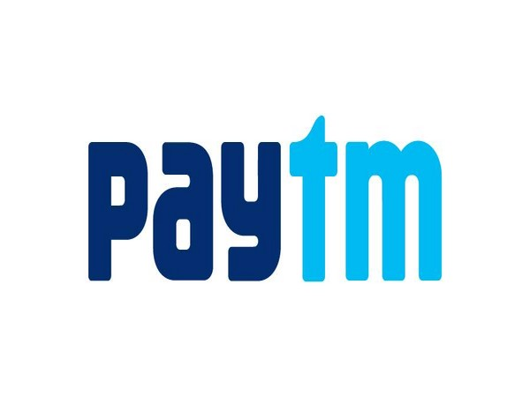
Paytm Pitch Deck
Convert existing users into power users

Slide 2

Problem
Understanding the problem statement to analyze key terms and solutions
1
15% drop in Women customer Footfall
25% fall in Scan and Pay as well as insta transfer to Mobile No
3
2
25% Paytm customers moving to Other Platforms
20% fall in Utility payments .11% Customers moving to Other paltforms for Mobile Recharge
4
5
Complains regarding Brands Collaboration
6
Cashback or Discount for Commercial payments

Slide 3












About Me:
USER PERSONA – JESS PATEL –Surat Diamond King
Bio Jess patel A tech savy Middle aged gentleman working as Gold and Diamond Merchant for last 10 years. He has grew his wealth and bought a 3 BHK apartment . He has currently bought another villa on Home Loan. Sent his 2 kids to a pvt Convent school. His wife is Home Maker . He is working with 50+ vendors and major jewellery brands across India. He has workshop in his new villa where he has recruited 75 workers .He prefer to go cashless .He owns Iphone14.Always prefers to use Paytm for cashless transfer and paying the utilities
Goal : To effectively spend utility and rental payments through paytm and expecting offers and cashbacks
“Take a risk and keep testing because what works today wont work tomorrow but what worked yesterday may work again”
Image is customizable
Demography and Geography Age: 46 Education: Diploma in Jewellery Design Work: Diamond and Gold Merchant
LifeStyle: father with 2 Kids.Own a 3 Bhk apartment in Borivoli. Boiught Nexus 2 years ago and currently paying EMI on 2nd car
Salary : 7 Lakhs per Month Marital status: married Location: Mumbai
Goals
Paying Home Emi through UPI
Going cashless for regular expenditure including groceries
Avail discounts and cashback
Like to stop using debit card and don’t want to keep liquid money
Vijay Verma
38, Senior Manager at a well- established SME
Influencers and brands
Frustrations :
User wants to reward his employees through brands offered discounts and offers
He wants to include his customers through some reward program to increase engagement
His wife and kids looks for brands rewards program for their daily uses which force them to use other Apps
There is no cashback or loyalty accrual l while dealing transactions workth lakhs
Needs
Looking to share discount vouchers or gift through redeem coupons to his employees
Give cashback offers to his customers
Looking for Women brands offering through Paytm to lure women customers to buy or trade with him
Payments :

Slide 4






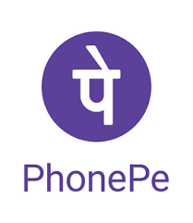

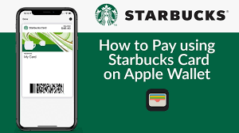

USER PERSONA – Alexis – Moon Failry
Bio Alexis is a dedicated ,hard working finance professional having more than 6 years of experience in data analysis .She is budding data scientist . She owns a cloud kitchen which runs on weekends. She is staying in rented place with her friend and pay around 25K . She bought items through online App and often visits cafes and restaurants with her friends . She mostly pays her utility through mobile banking and aiming to go as much cashless possible. She has recently taken a loan to buy a 2 wheeler.
Amit Verma
“Take a risk and keep testing because what works today wont work tomorrow but what worked yesterday may work again”
Goals
Pay her EMI through UPI
Optimize processes to reduce unnecessary expenses
Facilitate her cloud kitchen payment cashless as still she has to deal with liquid cash
To pay her utility bills through UPI platform
Demography and Geography Age: 29 Education: B,Tech Work: Data Analyst at Myntra
LifeStyle: Visits restaurant often.Bought a Scootie on car loan. Residing in rented premises in koramangla. Order grocery and stationary through Online App.Prefers zomato.Often board Ola and Uber
Salary : 8 Lakhs per Month Marital status: married Location: Bangalore
Frustrations :
Often look for Discount codes and redemption points to avail discount on online purchase
Unable to avail coupon Code for hotel and restaurant redemption through paytm
There is no loyalty points in Paytm which she wants to offer to her kitchen customers
During festive season she wants to offer exclusive brands promotional offers to her customers and vendors to enhance her business
Needs
Looking for Brands promotional offers through paytm
Annual memebership program with paytm to get cashbacks as she pays her staff , customers ,vendors through paytm
Redemption Points Accrual for every transaction
Wants Paytm to come up with gold membership plan same as Zomato
App used:

Slide 5
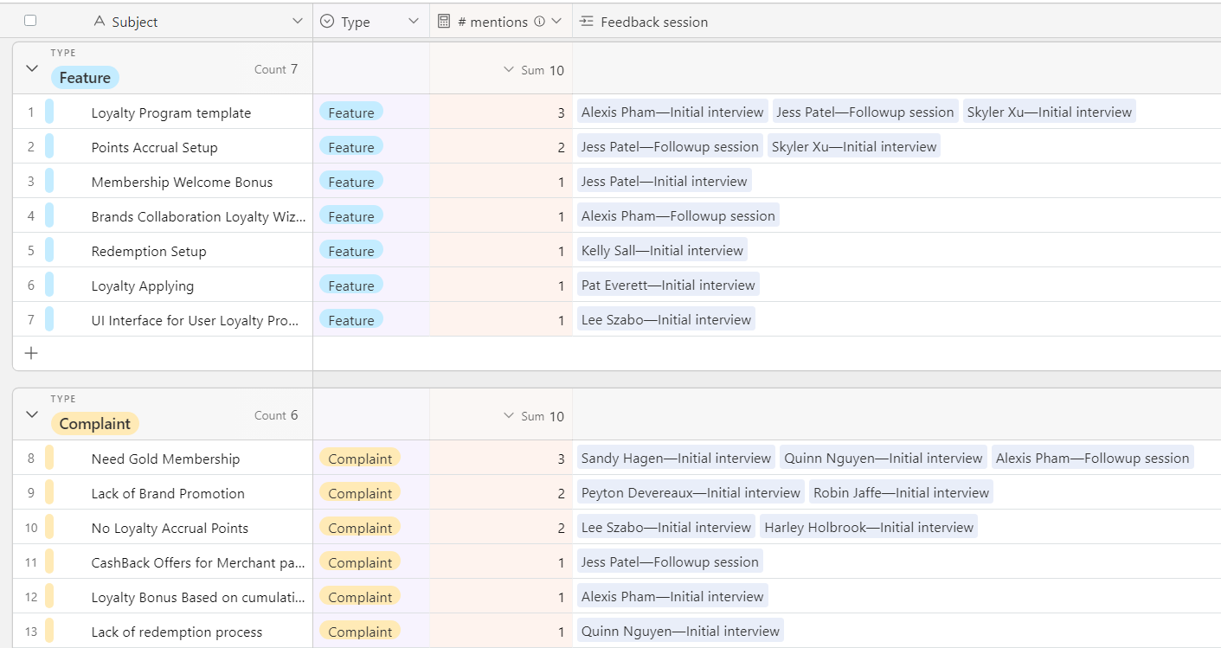
User Interview Schedule

Slide 6

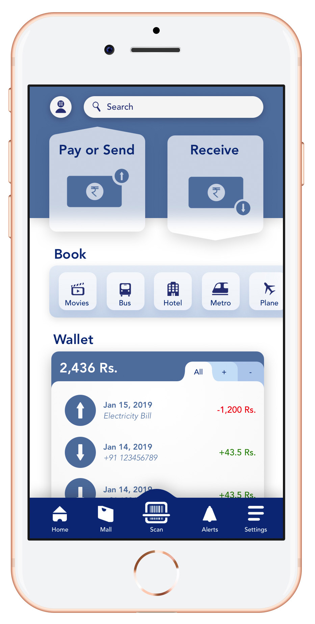



Solution
Recommendation Engine
Boosting overall Spending
Loyalty Program
Customer Retention
Gold Membership
Welcome Bonus For Brands on Successful onboarding
User Retention And Engagement
Cashback on every Insurance ,Loan , Mobile recharge payment
Discount coupons for Jewellery and merchandise Brands
Brand Collaboration
10 Loyalty Points equivalent to 1 INR above 500 INR transfer
Reward program for Gold members in selected flights and Hotel booking

Slide 7
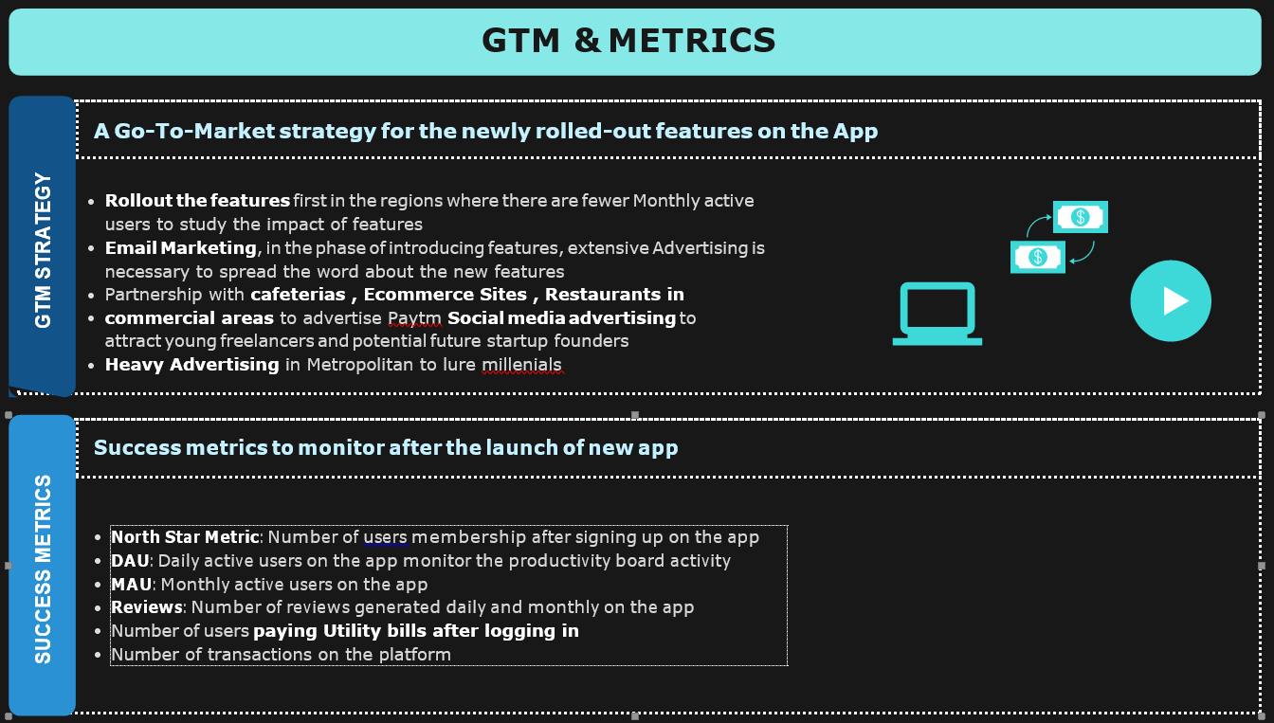

Slide 8
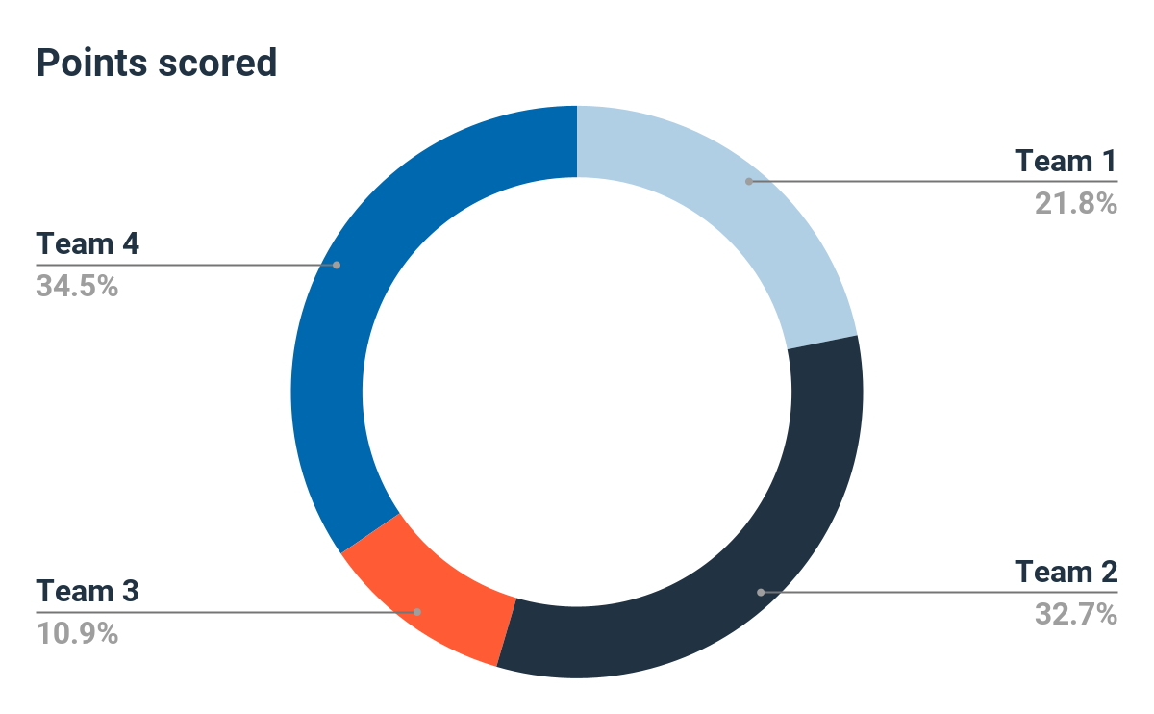
Market Adoption
Quarter Market Penetration

